Slide 1
Continual Reinforcement Learning for Evolving Games: Learning Across Game Updates in Competitive Pokémon
Thomas Vroom

Slide 2
Content
Introduction
Competitive Pokémon
Preliminary Experiments & Results
Methods
Experiments & Results
Conclusion

Slide 3
Introduction

Slide 4
Introduction
Reinforcement Learning (RL) can achieve superhuman performance in sequential decision-making tasks.
Two phases: Training and Deployment → Stationarity Assumption
Is it realistic? Autonomous driving, recommender systems, games…
Modern games are live-service: they receive frequent balance patches, content updates, seasonal events, etc.
Keep using the same strategy? → Unpredictable performance
Retrain after every update? → Expensive training costs
Transfer knowledge across game versions?

Slide 5
Introduction
Continual (Reinforcement) Learning: adapt to a sequence of tasks over time without forgetting previously learned knowledge.
Stability: preservation of previously acquired knowledge.
Plasticity: ability to learn new information.
Catastrophic forgetting: learning new information degrades performance on previously learned tasks.
Loss of plasticity: networks gradually lose their ability to adapt to new tasks or changing data over time.

Slide 6
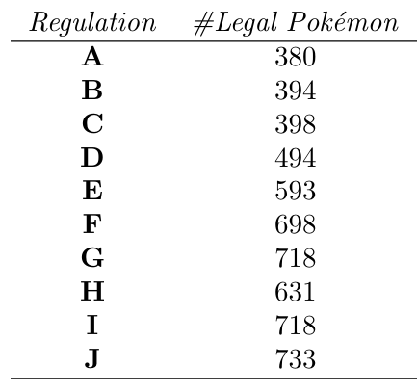
Introduction
We investigate whether continual reinforcement learning can facilitate effective knowledge transfer in a non-stationary, competitive game.
Our domain is competitive Pokémon, also known as VGC.
Legal Pokémon change under seasonal rulesets.
Intuitive example of non-stationarity.
Clear opportunity for knowledge transfer.
Clear task boundaries.

Slide 7
Introduction - Research Questions
What effect does non-stationarity have on the performance and generalization of reinforcement learning agents in VGC?
Can continual reinforcement learning methods facilitate effective knowledge transfer across game versions?
How do continual reinforcement learning-based agents compare to fully retrained agents in terms of performance, generalization, and training cost across game updates?

Slide 8
Competitive Pokémon

Slide 9
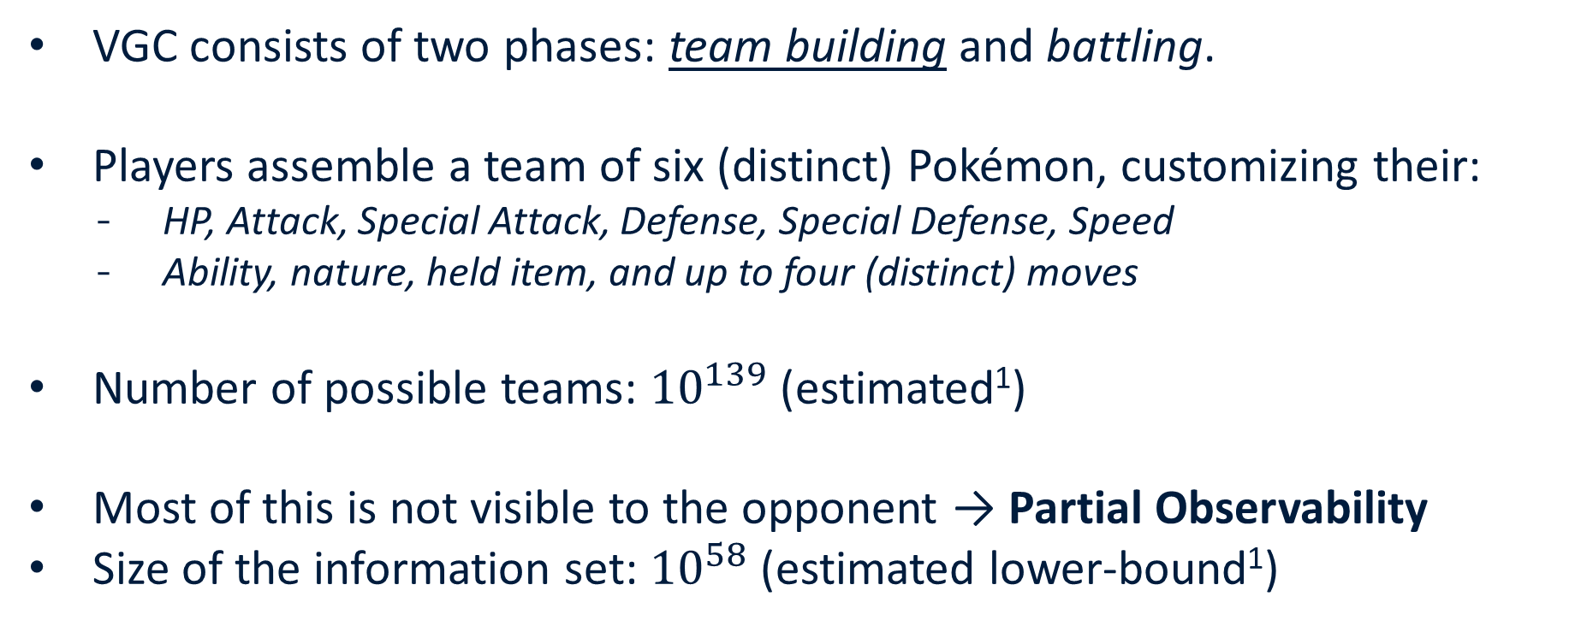
Competitive Pokémon
VGC consists of two phases: team building and battling.
Players assemble a team of six (distinct) Pokémon, customizing their:
HP, Attack, Special Attack, Defense, Special Defense, Speed
Ability, nature, held item, and up to four (distinct) moves
Number of possible teams: ${10}^{139}$ (estimated¹)
Most of this is not visible to the opponent → Partial Observability
Size of the information set: ${10}^{58}$ (estimated lower-bound¹)
[1] Angliss et al. "VGC-Bench: Towards Mastering Diverse Team Strategies in Competitive Pokémon.“ (2025)

Slide 10
Competitive Pokémon
VGC consists of two phases: team building and battling.
A player has two Pokémon active at once (two more to switch in later).
Battles play out in turns, but players make moves simultaneously:
Attack one or both opponent’s Pokémon.
Switch one or both Pokémon out.
Select a utility move.
Move outcomes involve a large amount of random chance:
Miss target, secondary effects, status conditions, critical hits, etc.
Objective: knock out all the opponent’s Pokémon (two-player zero-sum)

Slide 11
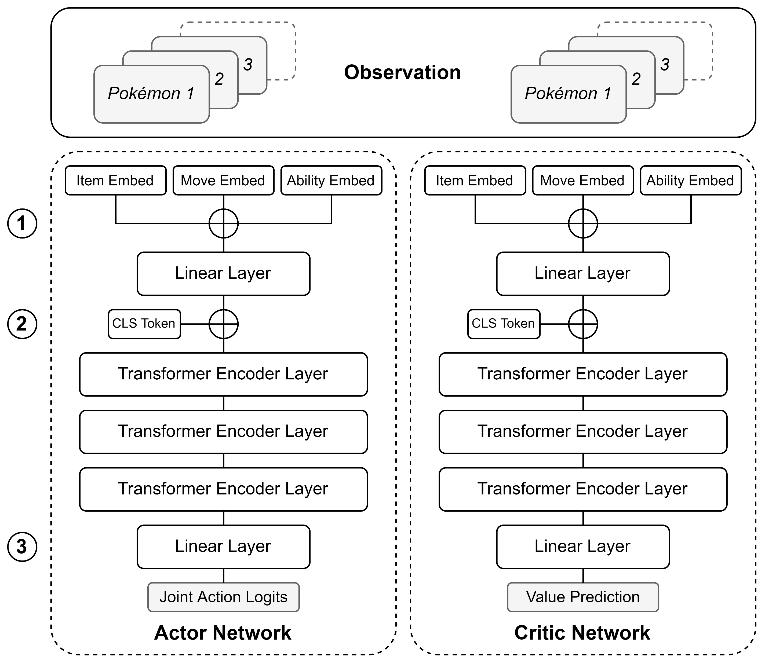
Competitive Pokémon
Training RL agents on VGC → VGC-Bench¹
Multi-agent RL environment for VGC.
Meta-relevant teams for each regulation.
Various baseline agents, incl. fine-tuned behavior cloning and self-play RL.
All agents trained using Proximal Policy Optimization (PPO).
In-distribution set: teams seen during training.
Out-of-distribution set: teams not seen during training.
Fine-tuned behavior cloning + Less teams seen during training performs best.
[1] Angliss et al. "VGC-Bench: Towards Mastering Diverse Team Strategies in Competitive Pokémon.“ (2025)

Slide 12
Preliminary Experiments

Slide 13
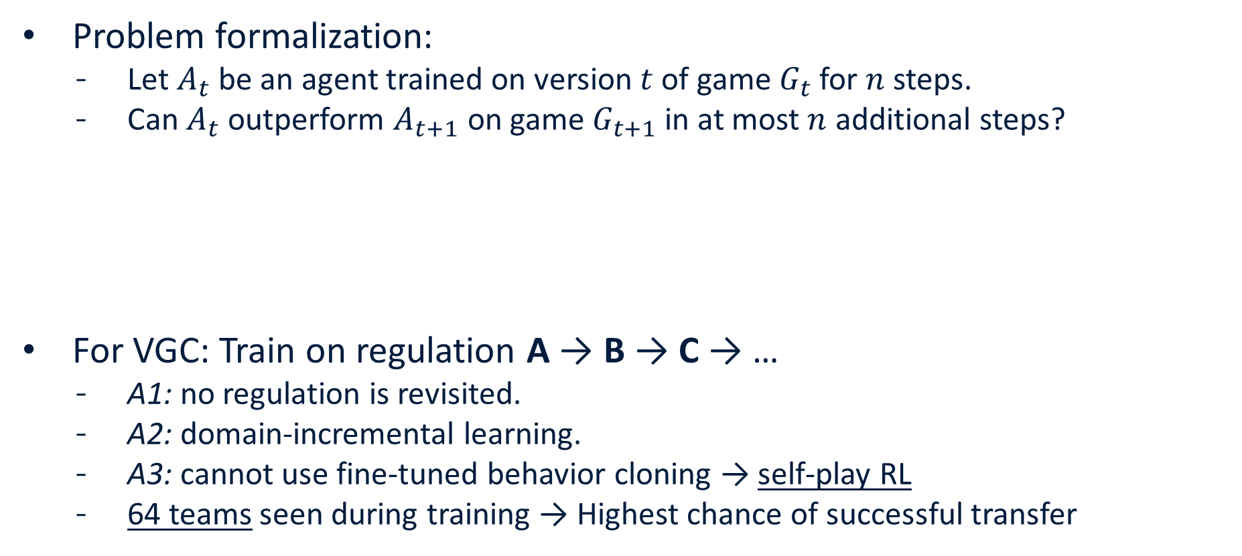
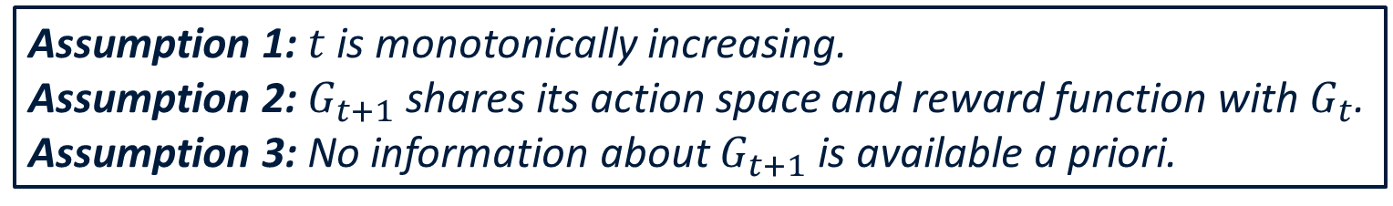
Preliminary Experiments
Problem formalization:
Let $A_{t}$ be an agent trained on version $t$ of game $G_{t}$ for $n$ steps.
Can $A_{t}$ outperform $A_{t+1}$ on game $G_{t+1}$ in at most $n$ additional steps?
For VGC: Train on regulation A → B → C → …
A1: no regulation is revisited.
A2: domain-incremental learning.
A3: cannot use fine-tuned behavior cloning → self-play RL
64 teams seen during training → Highest chance of successful transfer
Assumption 1: $t$ is monotonically increasing.
Assumption 2: $G_{t+1}$ shares its action space and reward function with $G_{t}$.
Assumption 3: No information about $G_{t+1}$ is available a priori.

Slide 14
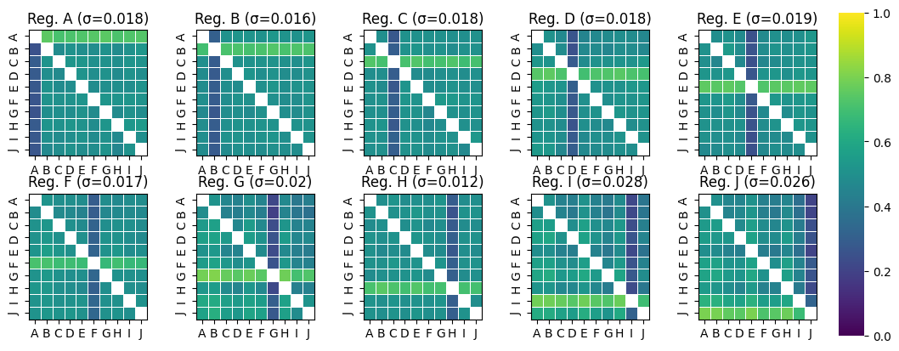
Preliminary Experiments - Zero-Shot Transfer
What effect does non-stationarity have on the performance and generalization of reinforcement learning agents in VGC?
(1000 games, 3 seeds, in-distribution)

Slide 15
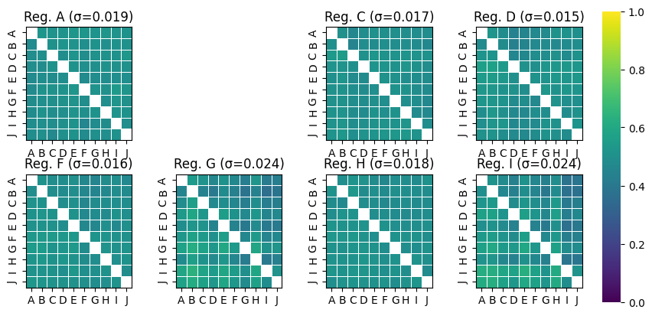
Preliminary Experiments - Zero-Shot Transfer
What effect does non-stationarity have on the performance and generalization of reinforcement learning agents in VGC?
(1000 games, 3 seeds, out-of-distribution)

Slide 16
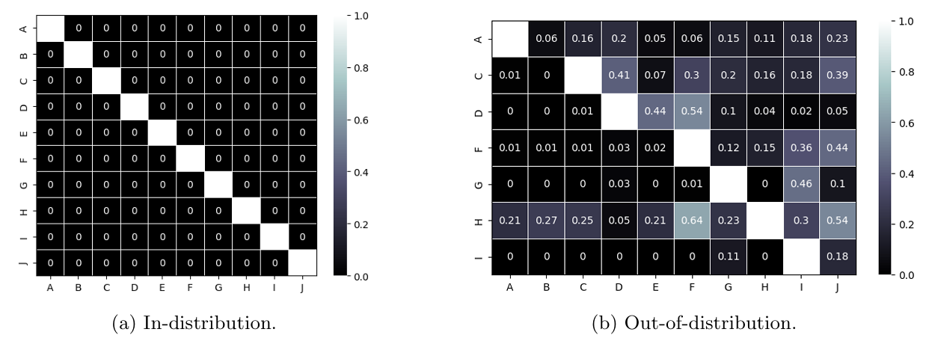
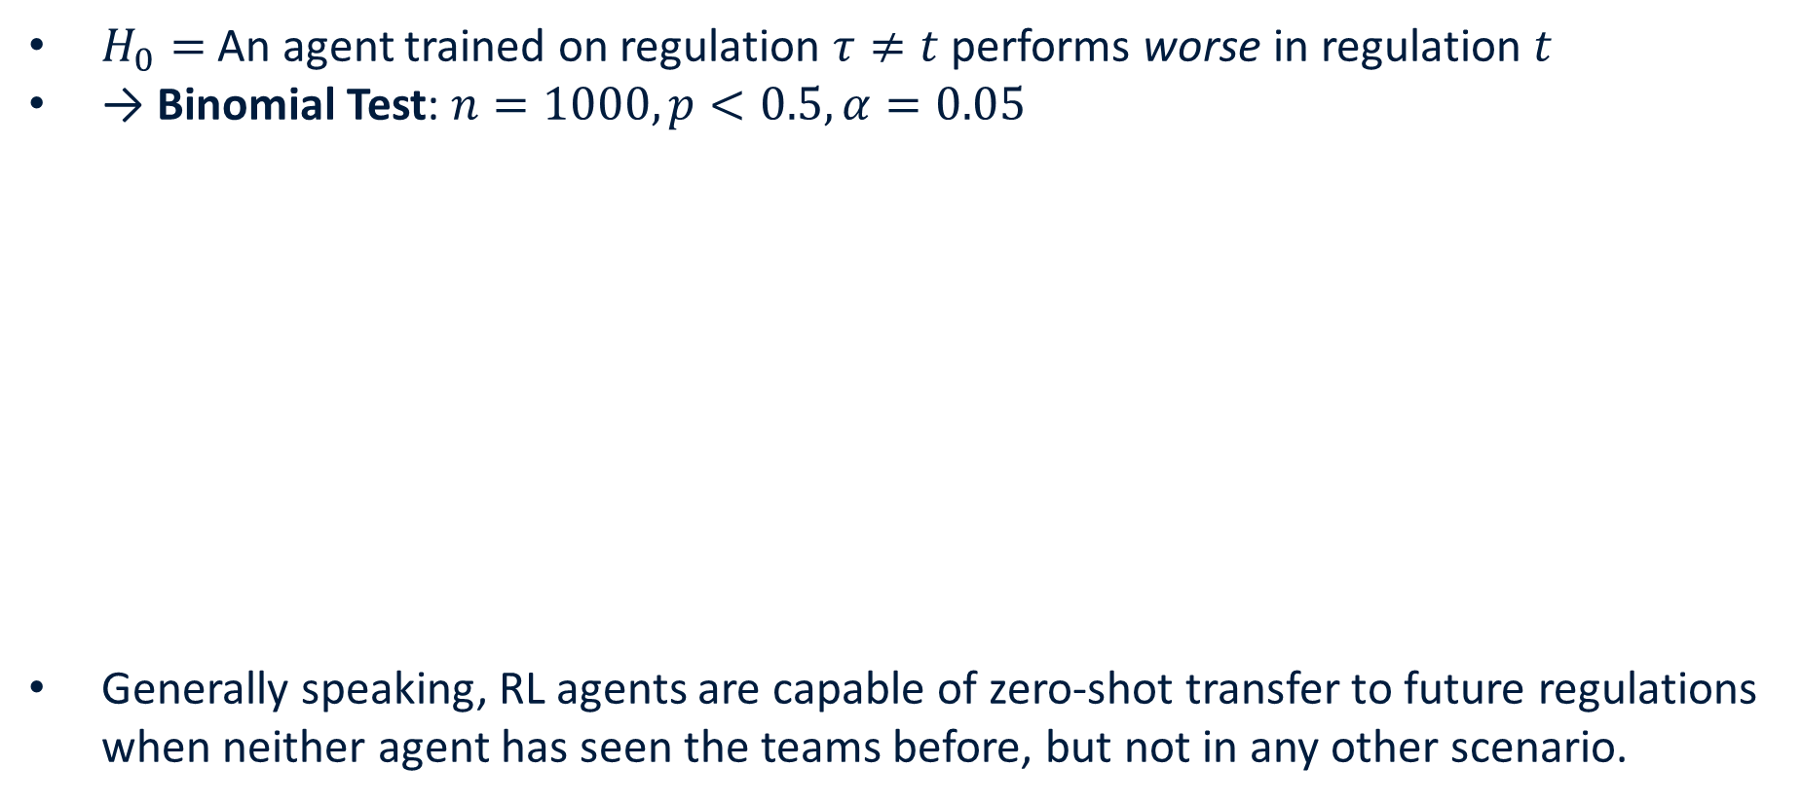
Preliminary Experiments - Zero-Shot Transfer
$H_{0}=$ An agent trained on regulation $τ≠t$ performs worse in regulation $t$
→ Binomial Test: $n=1000, p<0.5, α=0.05$
Generally speaking, RL agents are capable of zero-shot transfer to future regulations when neither agent has seen the teams before, but not in any other scenario.

Slide 17
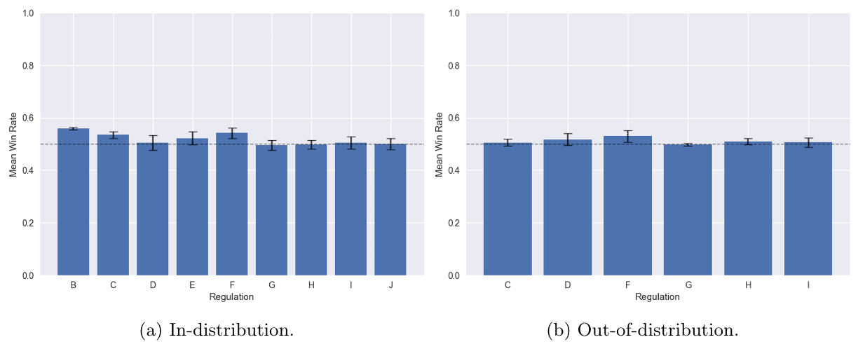
Preliminary Experiments - Full Fine-Tuning
To what extend are reinforcement learning agents able to maintain performance under non-stationarity without any continual learning methods.
(1000 games, 3 seeds)

Slide 18
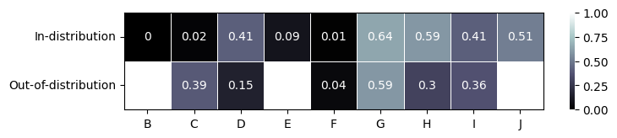
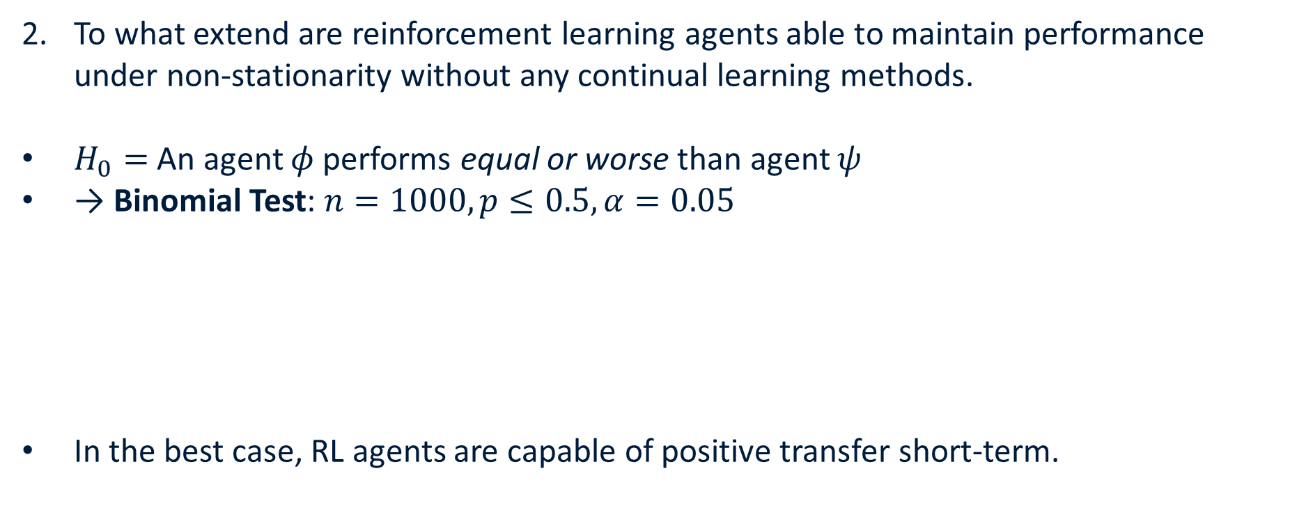
Preliminary Experiments - Full Fine-Tuning
To what extend are reinforcement learning agents able to maintain performance under non-stationarity without any continual learning methods.
$H_{0}=$ An agent $φ$ performs equal or worse than agent $ψ$
→ Binomial Test: $n=1000, p≤0.5, α=0.05$
In the best case, RL agents are capable of positive transfer short-term.

Slide 19
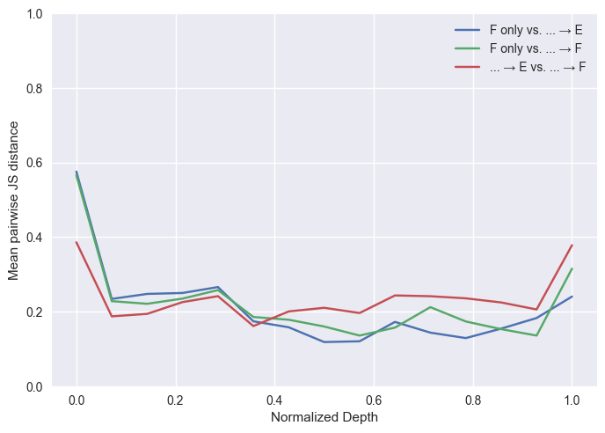
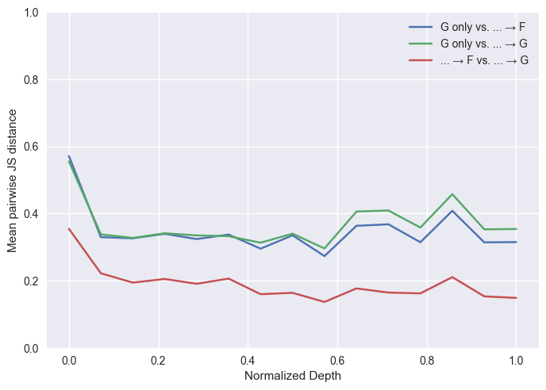
Preliminary Experiments - Analysis
Mean pairwise Jensen-Shannon distance between action probabilities:
(Regulation F, in-distribution)
(Regulation G, in-distribution)

Slide 20
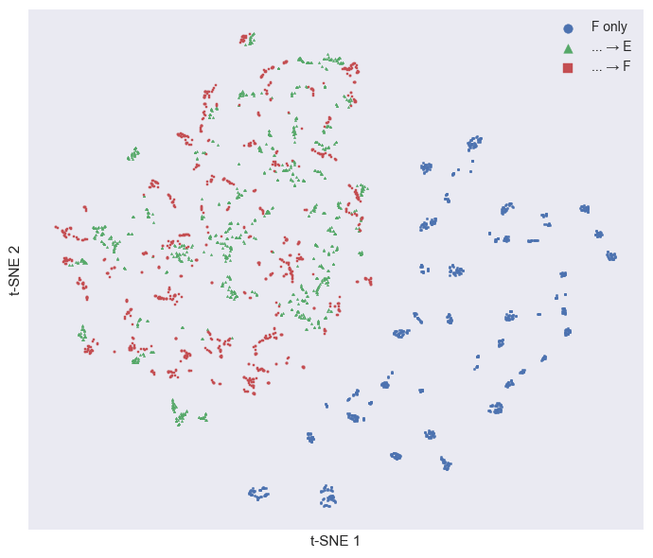
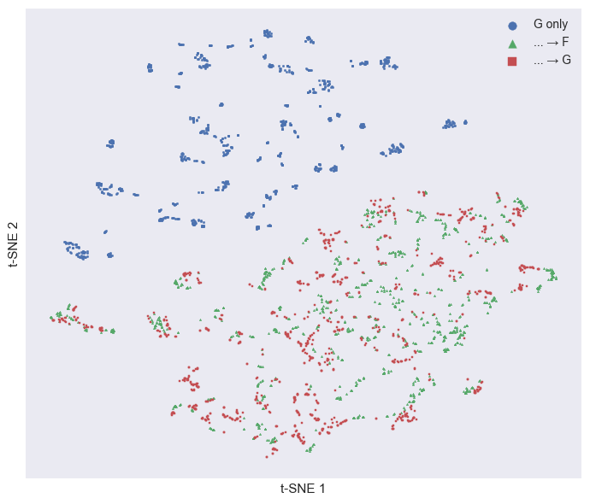
Preliminary Experiments - Analysis
Distributions of action logits (t-SNE):
(Regulation F, in-distribution)
(Regulation G, in-distribution)

Slide 21
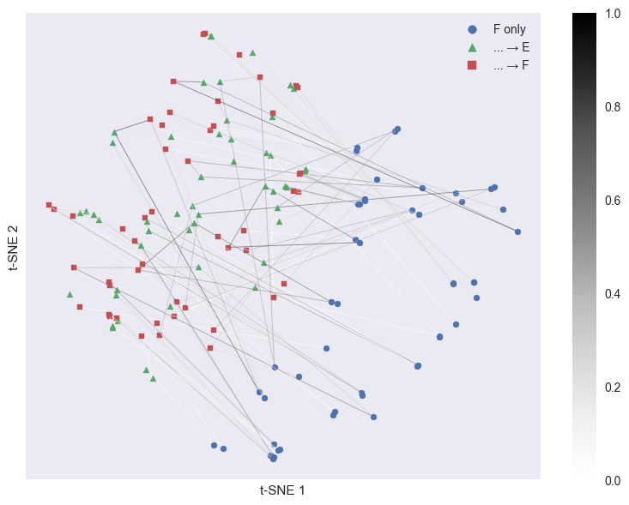
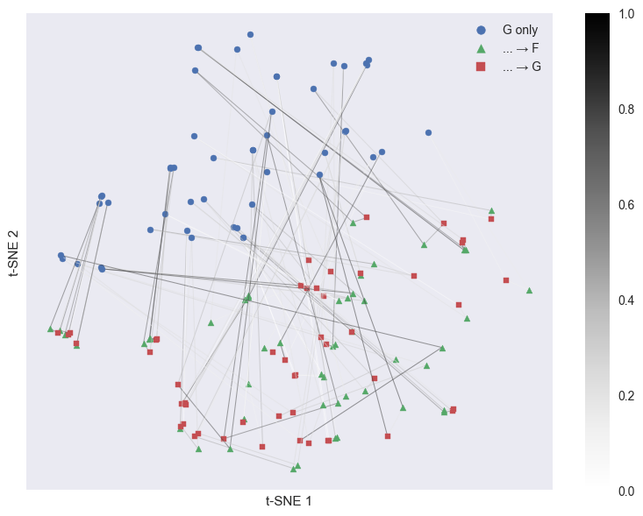
Preliminary Experiments - Analysis
Distributions of action logits (t-SNE), Jensen-Shannon distance (lines):
(Regulation F, in-distribution)
(Regulation G, in-distribution)

Slide 22
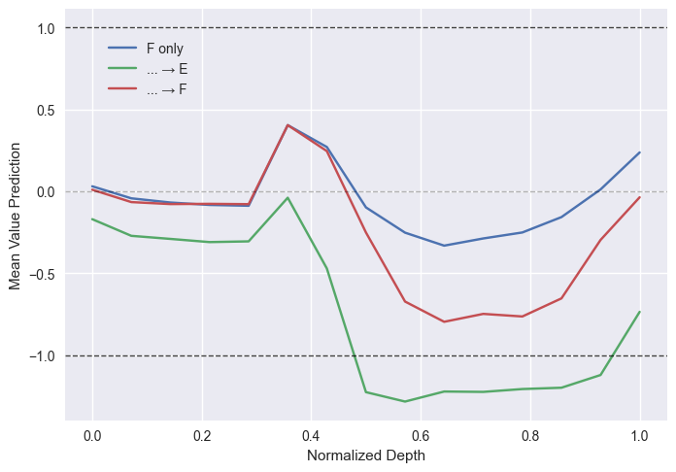
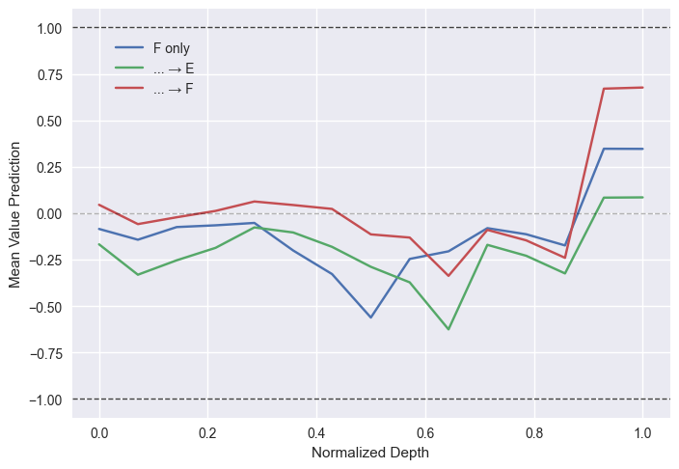
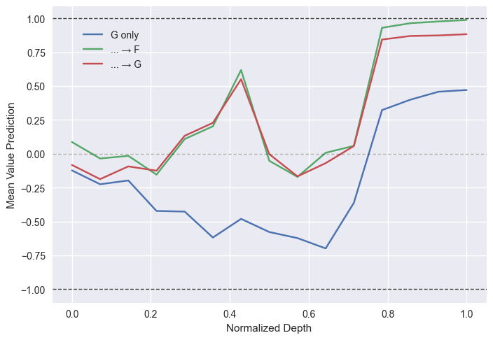
Preliminary Experiments - Analysis
Mean value prediction:
(Regulation F, in-distribution)
(Regulation F, out-of-distribution)
(Regulation G, out-of-distribution)

Slide 23
Methods

Slide 24
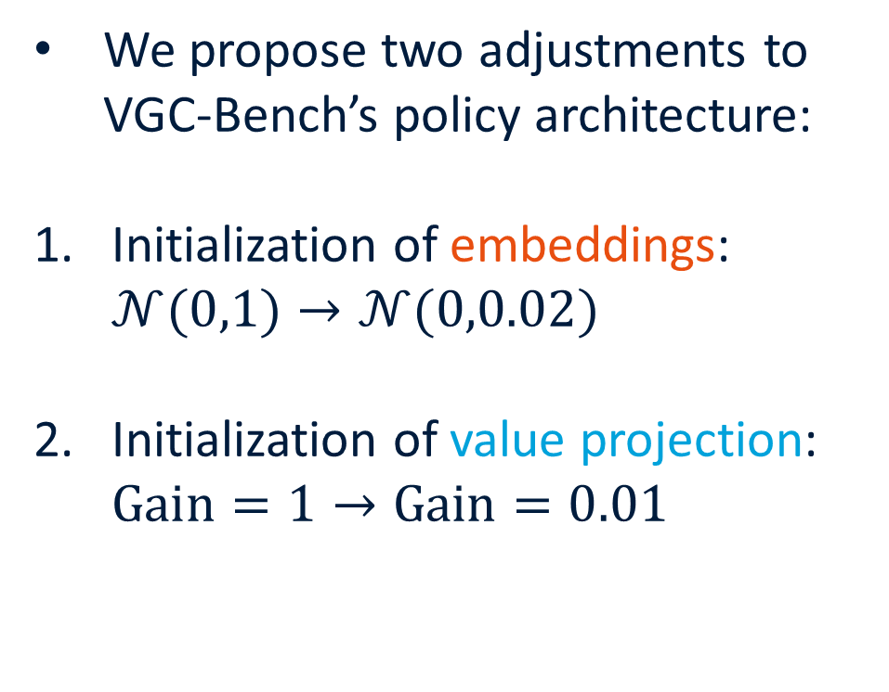
Methods - Value Stability
We propose two adjustments to VGC-Bench’s policy architecture:
Initialization of embeddings: $𝒩(0,1)→𝒩(0,0.02)$
Initialization of value projection: $\text{Gain}=1→\text{Gain}=0.01$

Slide 25
Methods - Continual Reinforcement Learning
Regularization methods: penalize changes to important parameters.
Elastic Weight Consolidation, EVCL, Synaptic Intelligence
Policy Distillation: Actor-Mimic, Distral
Replay methods: store and replay examples from previous tasks.
CLEAR, EDER
Parameter-isolation methods: allocate separate parameters for tasks.
Progressive Architectures: Progressive Neural Networks¹, PathNet, LoRA
Specialized Optimization Methods: ReDo, Continual Backprop, Tuned PPO²
[1] Rusu et al. "Progressive neural networks.“ (2016)
[2] Dohare et al. "Loss of plasticity in deep continual learning." (2024)

Slide 26
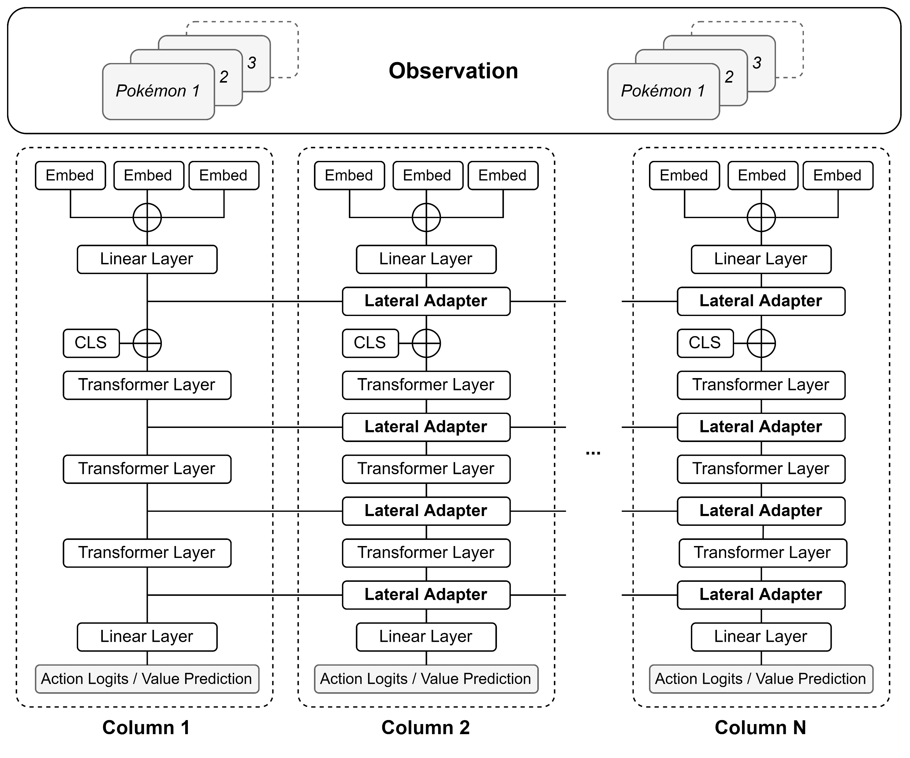
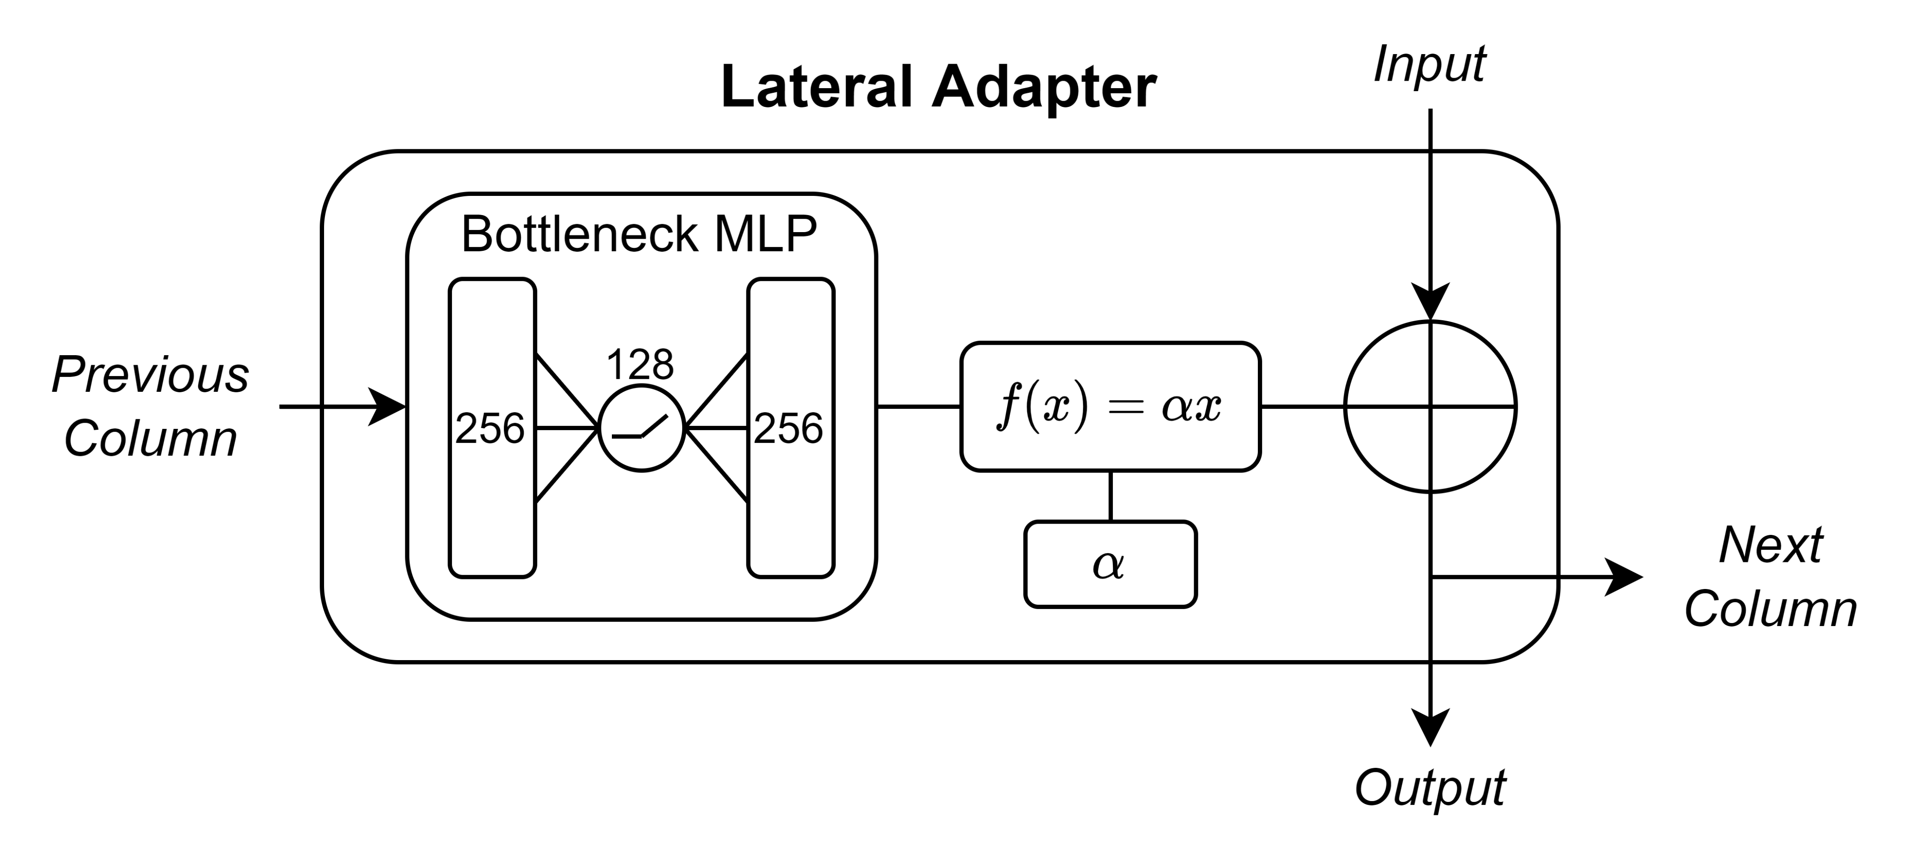
Methods - Progressive Architecture

Slide 27
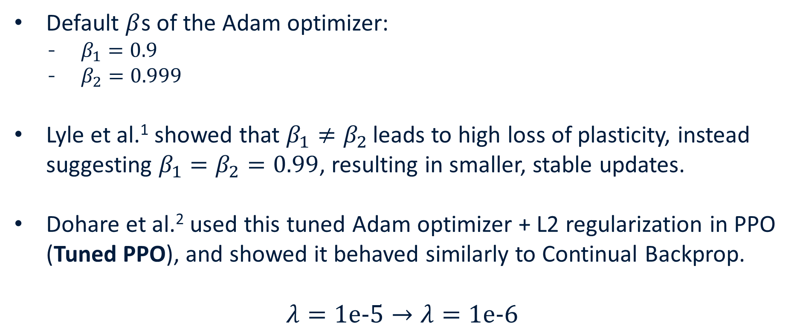
Methods - Tuned PPO
Default $β$s of the Adam optimizer:
$β_{1}=0.9$
$β_{2}=0.999$
Lyle et al.¹ showed that $β_{1}≠β_{2}$ leads to high loss of plasticity, instead suggesting $β_{1}=β_{2}=0.99$, resulting in smaller, stable updates.
Dohare et al.² used this tuned Adam optimizer + L2 regularization in PPO (Tuned PPO), and showed it behaved similarly to Continual Backprop.
$$λ=\text{1}\text{e}\text{-5}→λ=\text{1}\text{e}\text{-6}$$
[1] Lyle et al. “Understanding plasticity in neural networks” (2023)
[2] Dohare et al. "Loss of plasticity in deep continual learning." (2024)

Slide 28
Stationary Experiments

Slide 29
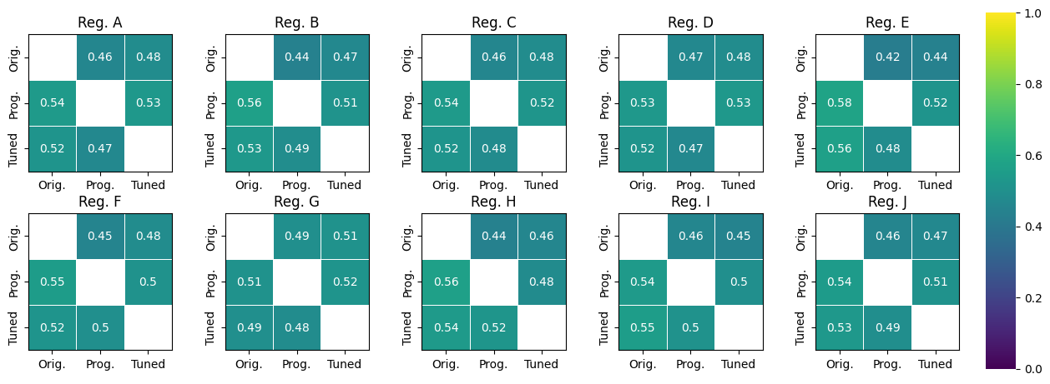
Stationary Experiments
(1000 games, in-distribution)

Slide 30
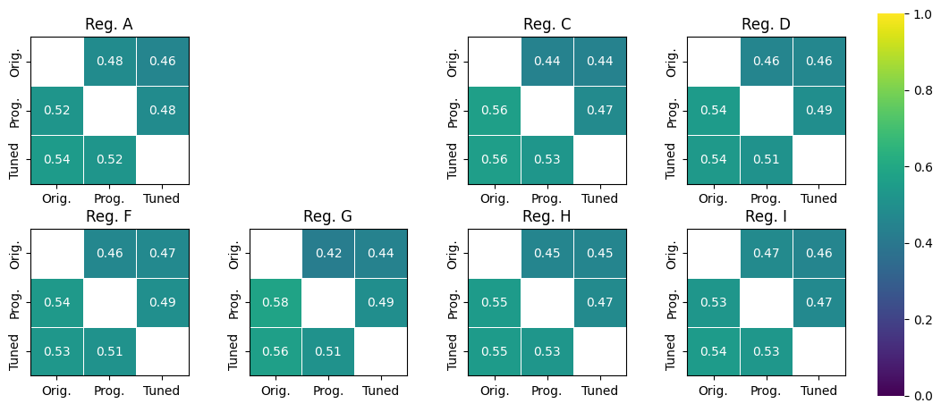
Stationary Experiments
(1000 games, out-of-distribution)

Slide 31
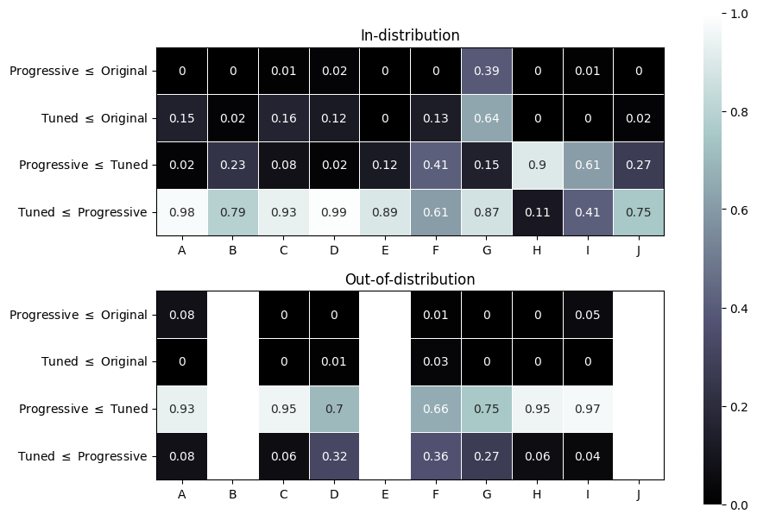

Stationary Experiments
$H_{0}=$ An agent $φ$ performs equal or worse than agent $ψ$
→ Binomial Test: $n=1000, p≤0.5, α=0.05$

Slide 32
Non-Stationary Experiments

Slide 33
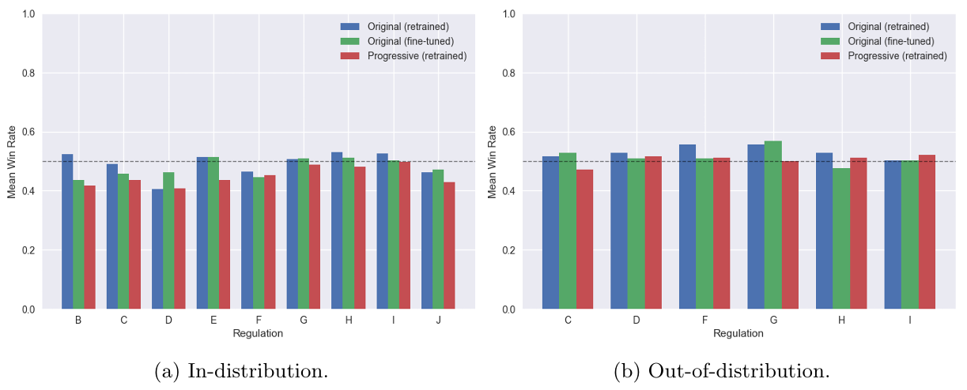
Non-Stationary Experiments
(1000 games, progressive)

Slide 34
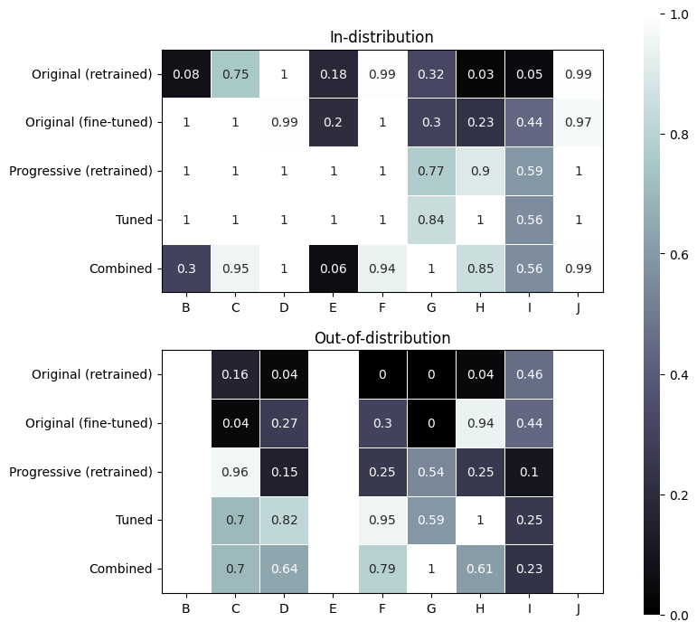
Non-Stationary Experiments

Slide 35
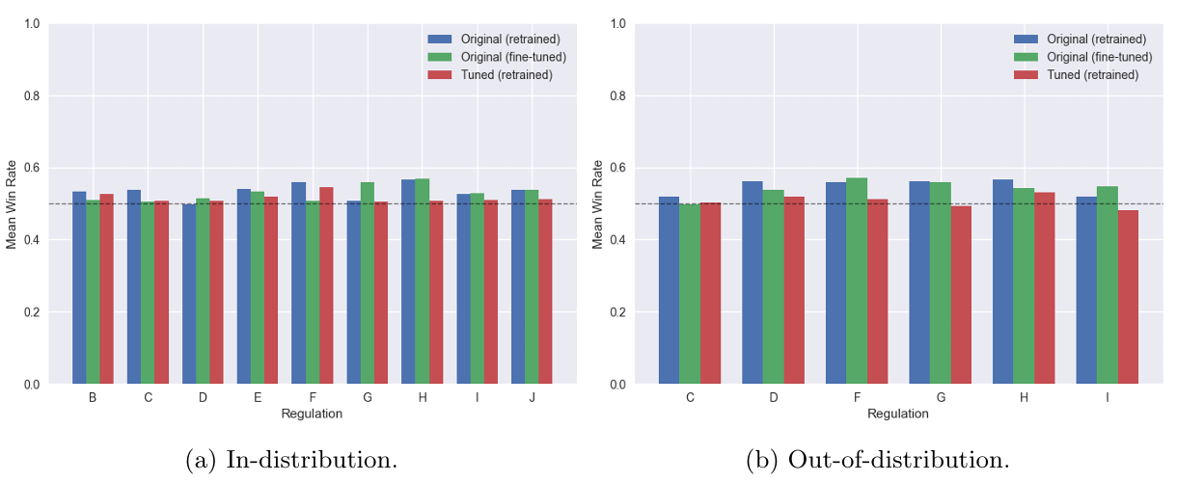
Non-Stationary Experiments
(1000 games, tuned)

Slide 36
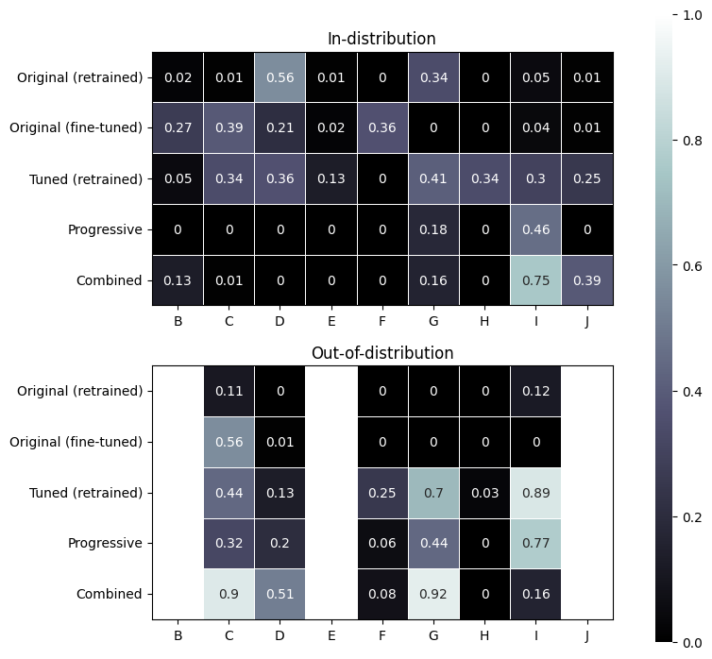
Non-Stationary Experiments

Slide 37
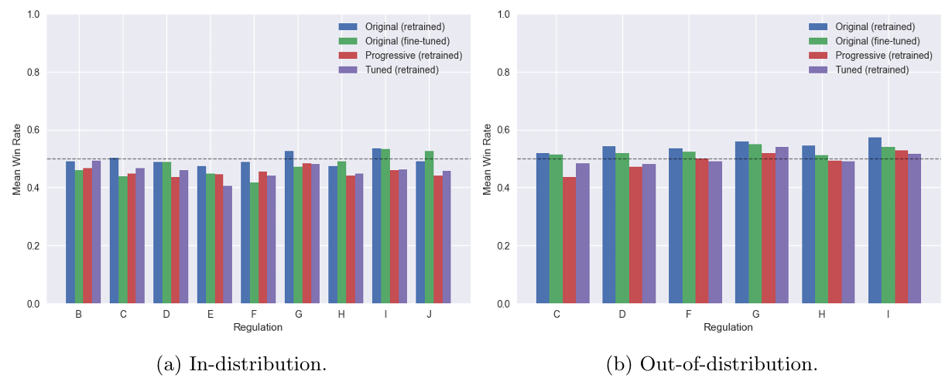
Non-Stationary Experiments
(1000 games, combined)

Slide 38
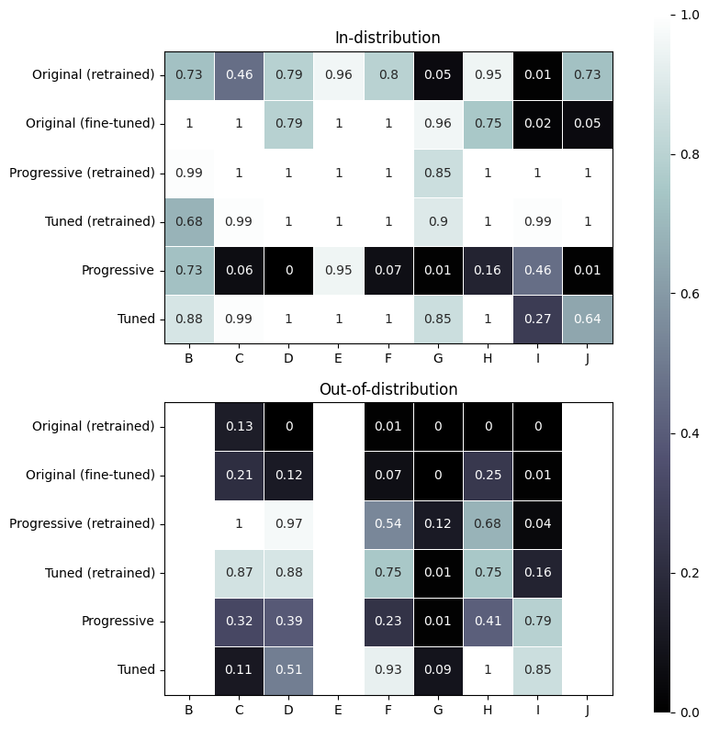
Non-Stationary Experiments

Slide 39
Analysis

Slide 40
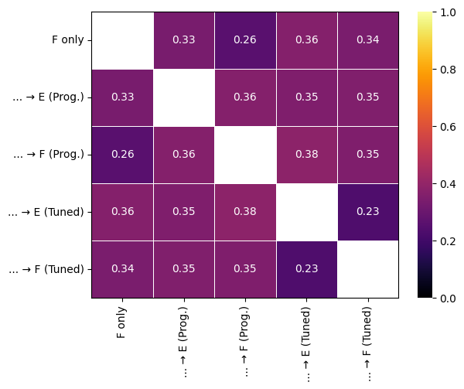
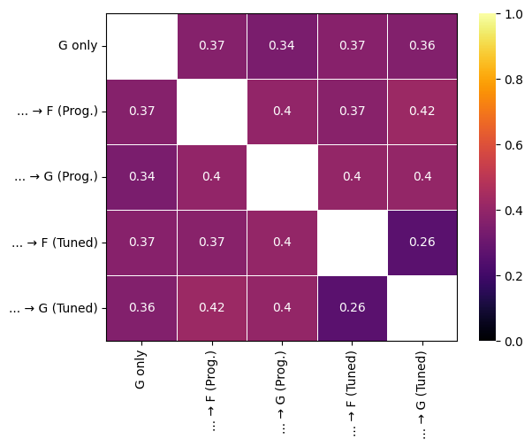
Analysis
Mean pairwise Jensen-Shannon distance between action probabilities:
(Regulation F, in-distribution)
(Regulation G, in-distribution)

Slide 41
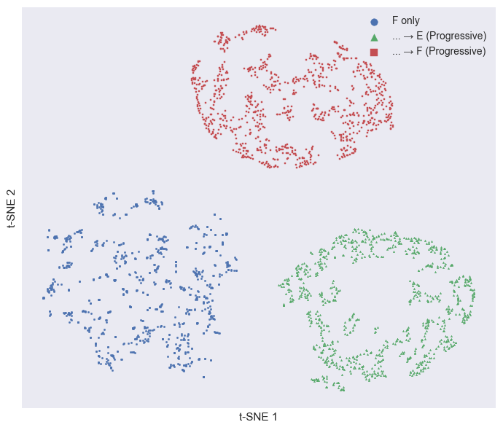
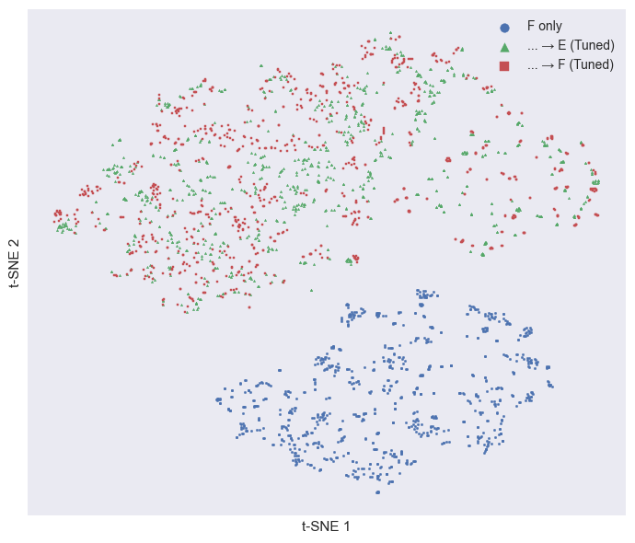
Analysis
Distributions of action logits (t-SNE):
(Progressive, Regulation F, in-distribution)
(Tuned, Regulation F, in-distribution)

Slide 42
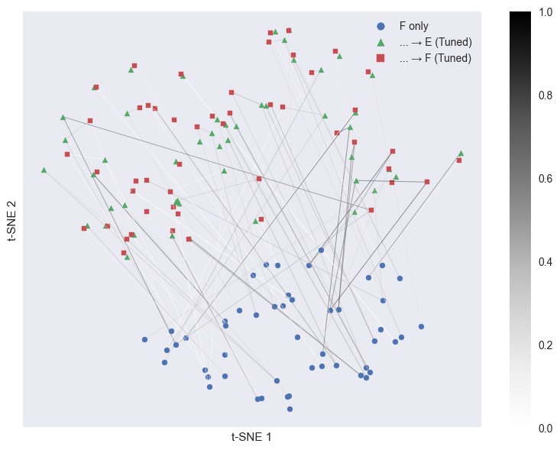
Analysis
Distributions of action logits (t-SNE):
(Progressive, Regulation F, in-distribution)
(Tuned, Regulation F, in-distribution)

Slide 43
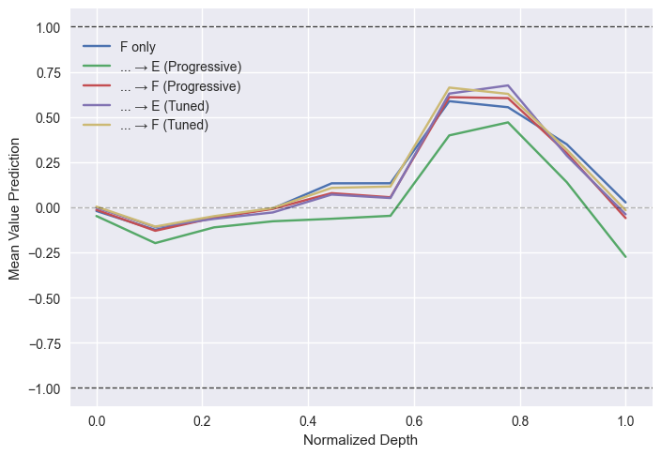
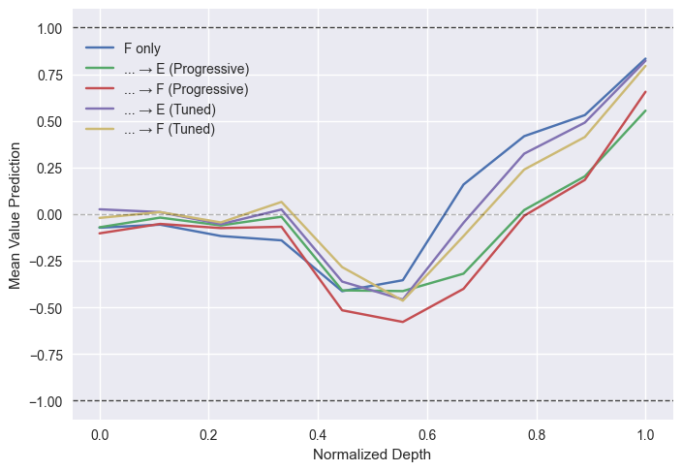
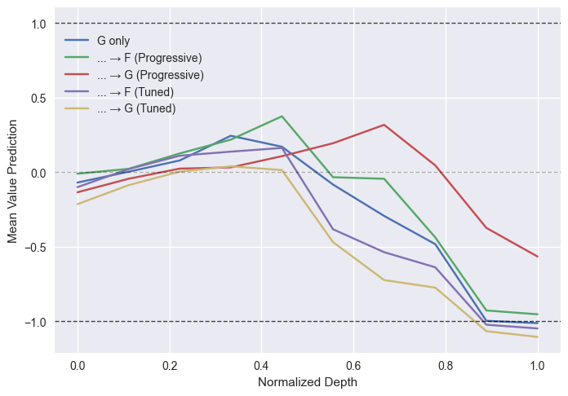
Preliminary Experiments - Analysis
Mean value prediction:
(Regulation F, in-distribution)
(Regulation F, out-of-distribution)
(Regulation G, in-distribution)

Slide 44
Conclusion

Slide 45
Conclusion
What effect does non-stationarity have on the performance and generalization of reinforcement learning agents in VGC?
Agents trained in one regulation are consistently worse than retrained agents in other regulations.
When evaluating for generalization, agents can match other agents trained on future regulations.

Slide 46
Conclusion
Can continual reinforcement learning methods facilitate effective knowledge transfer across game versions?
Agents can transfer knowledge short-term using full fine-tuning.
Our proposed network adjustments + tuned PPO outperform full fine-tuning, successfully prolonging the effective transfer.
Our progressive architecture is unable to facilitate better knowledge transfer, but does exhibit better generalization.

Slide 47
Conclusion
How do continual reinforcement learning-based agents compare to fully retrained agents in terms of performance, generalization, and training cost across game updates?
All our methods are unable to consistently outperform retrained agents.
Retrained agents are superior in terms of performance, generalization, and training cost, though continual learning appears to still be beneficial.

Slide 48
Future Work
Our experiments should be repeated on multiple seeds.
Possible directions:
The value function
L2 regularization rate
Number of teams used during training
Hyperparameters
ReDo & Continual Backprop
Regularization- & Replay methods
Progressive architecture
Custom regulations
Other games
…

Slide 49
Future Work
We believe continual learning in non-stationary games is a severely understudied domain that shows great potential.
Modern games, like VGC, have clearly defined rules, goals, and task boundaries.
Non-stationary games could serve as natural benchmark for continual learning, facilitating a greater understanding of how machine learning agents can remain effective after deployment.

Slide 50
Questions?

Slide 51
Appendix

Slide 52
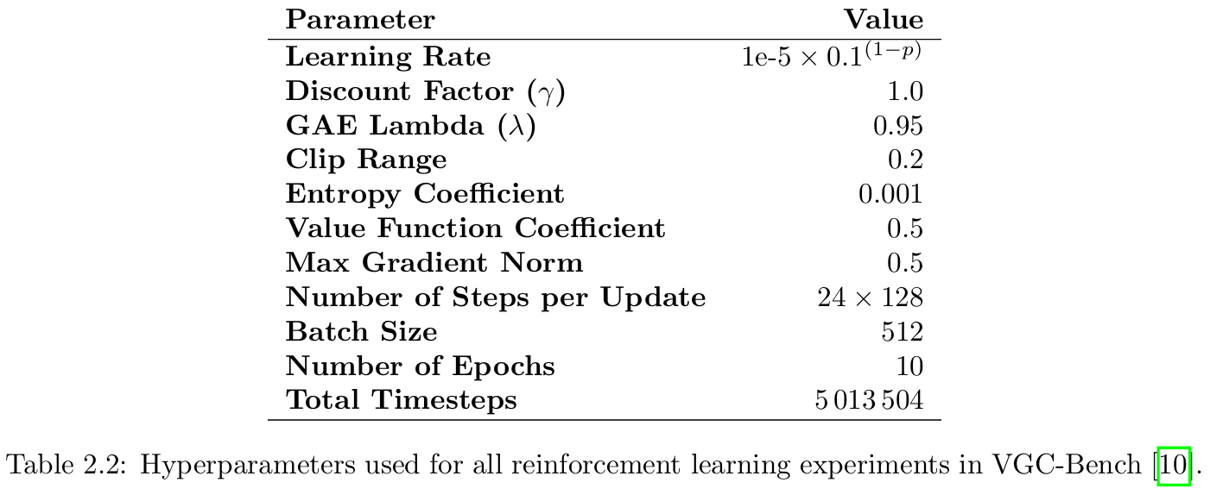
VGC-Bench Hyperparameters
[10] Angliss et al. "VGC-Bench: Towards Mastering Diverse Team Strategies in Competitive Pokémon.“ (2025)

